Slide 1
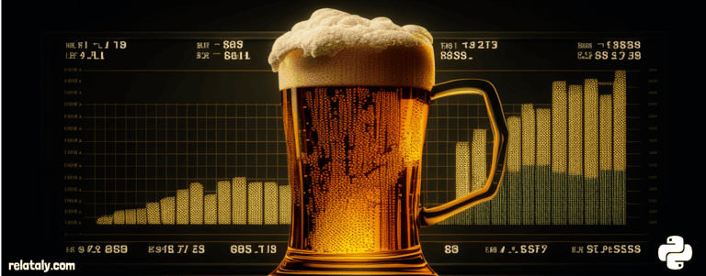
Title: Predicting Beer Production
Name: Triveni Bhaskar

Slide 2
Contents
Results and Discussion
Data Preprocessing and Exploration
Trend Analysis with Simple Moving Averages (SMA)
Model Selection and Forecasting
Autocorrelation and Partial Autocorrelation Analysis
Challenges
Future Improvements
Effectiveness of chosen model
Conclusion
Introduction
Objective
Dataset Overview
Relevance
Methodology
Data Preprocessing
Exploratory Data Analysis
Stationarity Check
Seasonal Decomposition
Model Selection and Forecasting
Autocorrelation Analysis

Slide 3
Introduction
This project focuses on analyzing and forecasting monthly beer production trends using advanced time series analysis techniques.
Leveraging a comprehensive dataset spanning from January 1956 to December 1993, covering historical records of beer production in Australia, our aim is to identify underlying patterns, trends, and seasonality.
By employing robust statistical methods and models, we seek to develop accurate forecasts for future production trends.
The insights derived from this analysis hold significant relevance for stakeholders in the brewing industry, facilitating informed decision-making and strategic planning based on reliable predictive analytics.
Dataset Overview: We utilize historical records of monthly beer production spanning from January 1956 to December 1993.

Slide 4
Data Preprocessing
The "Beer Production" dataset was imported into R using the readxl package to facilitate analysis.
Missing values, if any, were identified and subsequently removed using the na.omit() function to ensure data integrity.
3. After importing, an overview of the dataset's structure, column names, and sample entries was obtained to understand its characteristics.
4. The 'Month' column was converted into a Date object in the "%Y-%m-%d" format to enable time-series analysis.
5. The 'Monthly beer production' data was transformed into a time-series object named beer_ts using the ts() function in R.
6. The ts() function specified a frequency of 12 to represent monthly data, and the start parameter was set to the first year and first month.
7. These preprocessing steps prepared the dataset for further analysis, facilitating trend identification and forecasting of beer production.
Significance: Understanding beer production trends is crucial for stakeholders in the brewing industry, enabling strategic planning and resource allocation based on reliable predictive insights.

Slide 5
Exploratory Data Analysis
Data visualization: Utilized traditional plot and histogram to understand distribution and trends in monthly beer production.
Histogram analysis: Revealed right-skewed distribution indicating more months with lower production values.
Simple Moving Averages (SMA): Calculated SMAs with window sizes of 12, 24, and 36 months to smooth out fluctuations and visualize trends.
SMA visualization: Showcased original production data alongside SMA lines, indicating clearer trends with increasing window size.
Stationarity check: Conducted Augmented Dickey-Fuller (ADF) test, resulting in a p-value < 0.05, confirming stationarity for further analysis.
Seasonal decomposition: Employed multiplicative seasonal decomposition to understand trend, seasonality, and residuals in beer production time series.

Slide 6
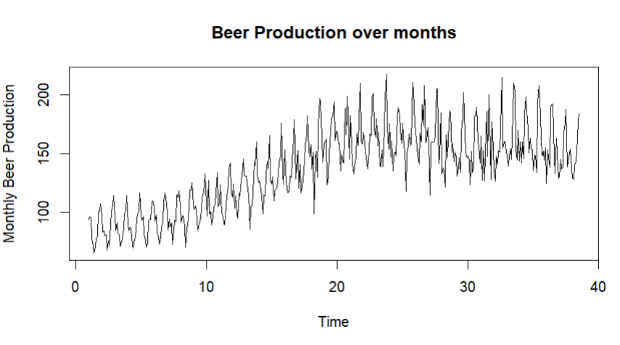
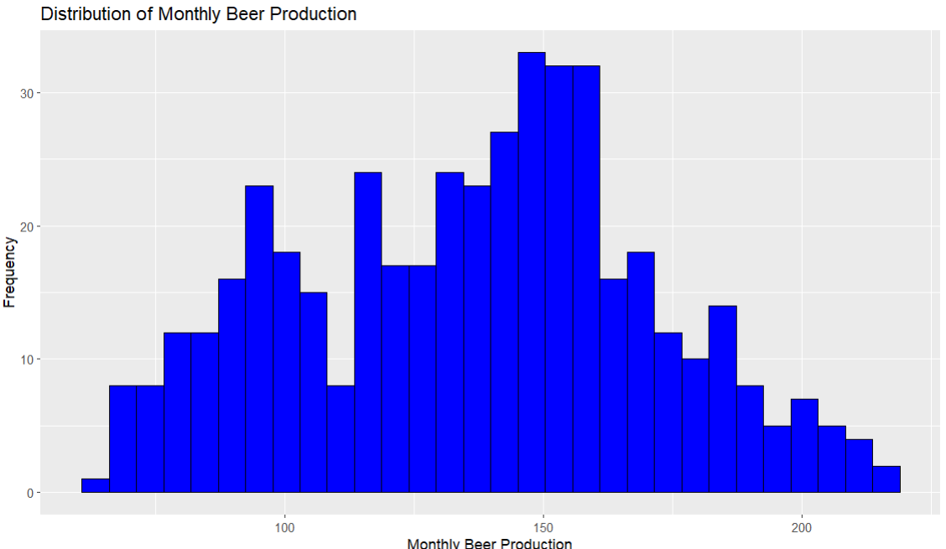
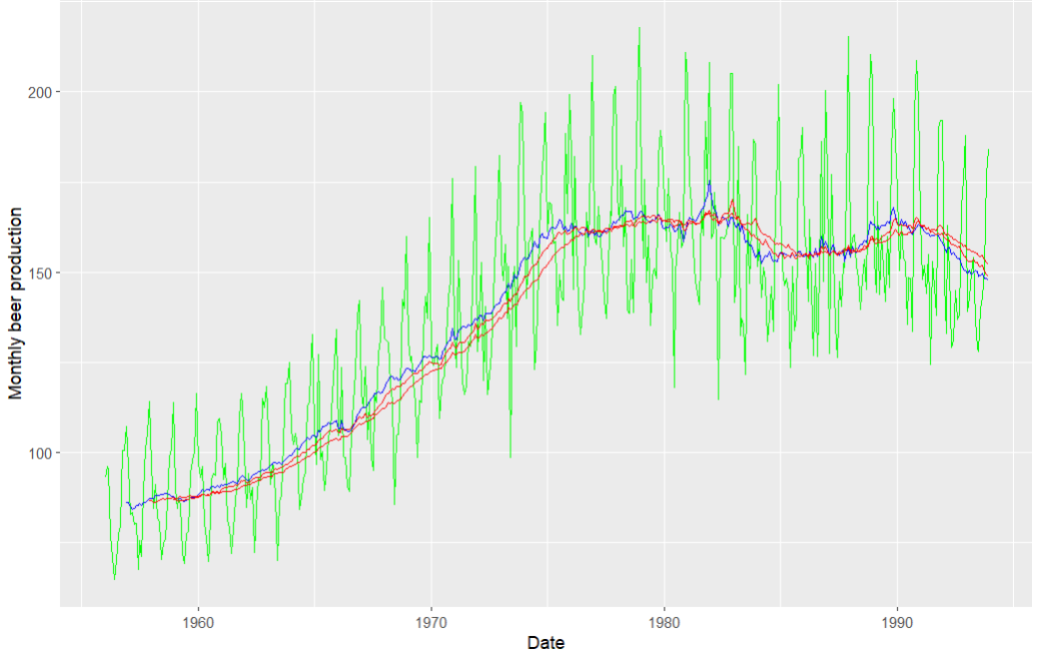
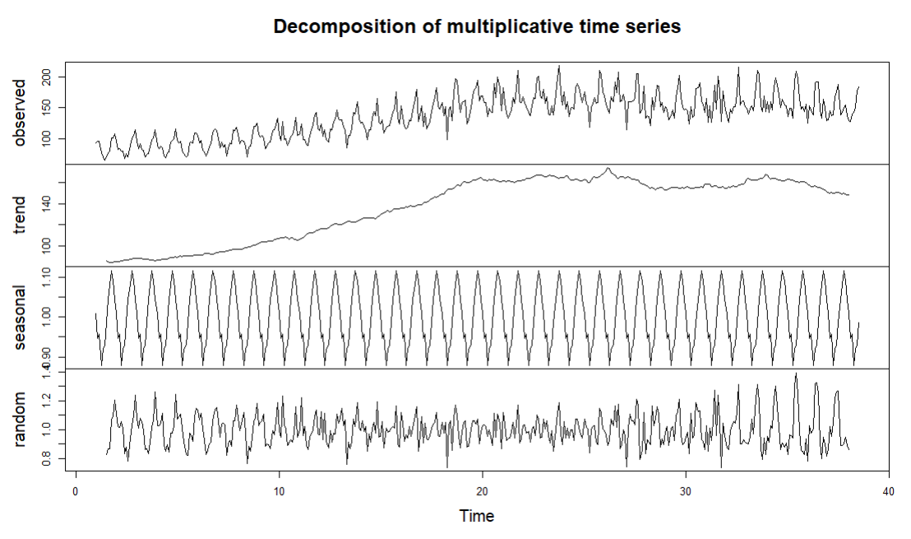
Outputs received for Beer Production Over Months, Distribution of Monthly Beer production, SMA, Decomposition

Slide 7
Model Selection and Forecasting
Two ARIMA models were fitted to the training data, and forecasts were generated for the next 20 time periods. While both models performed reasonably well, manual selection of parameters based on ACF and PACF plots led to a slightly improved model with a lower Mean Absolute Error (MAE).
Dataset split: Divided into training and testing sets for model evaluation.
Automated ARIMA model: Initially fitted using the 'auto.arima' function on the training data.
Manual model creation: A second model built manually based on ACF and PACF plots for parameter selection.
Forecast generation: Forecasts generated using both models, and Mean Absolute Error (MAE) calculated for performance evaluation.
Model validation: Residuals examined to ensure model adequacy and validate assumptions.
Output validation: Validation of ARIMA model's adequacy enhances confidence in forecasts for informed decision-making.
Forecast plotting: Forecasts for the next 20 time periods plotted to visualize predicted values and prediction intervals.
Mean Absolute Error (MAE): Calculated at 7.14, indicating the average absolute difference between forecasted and actual beer production values.

Slide 8
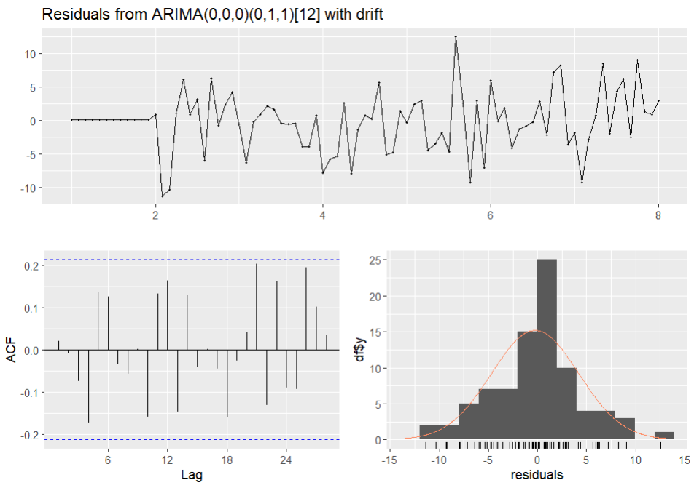
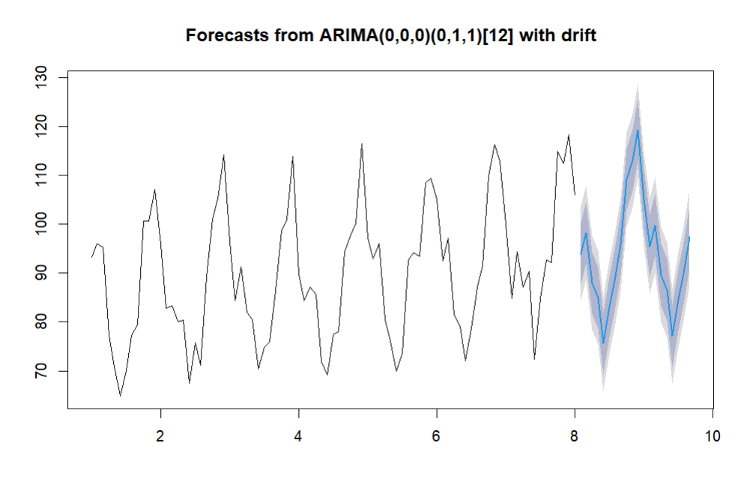
Outputs received: Residuals from ARIMA, Forecast Plot and Mean Absolute Error

Slide 9
Autocorrelation and Partial Autocorrelation Analysis:
Autocorrelation Function (PACF) plots aided in identifying potential ARIMA model parameters. These plots revealed significant autocorrelation patterns, assisting in the selection of appropriate model parameters for forecasting beer production.
ACF Plot:
Shows correlation between beer production values at different lags.
Helps identify temporal dependencies and patterns in the data.
Crucial for selecting parameters in time series models like ARIMA.
PACF Plot:
Illustrates partial correlation between beer production values at different lags.
Reveals direct relationship between observations after removing intervening effects.
Assists in determining autoregressive (AR) component order in ARIMA models.
ARIMA Model (Model2):
Parameters: p=3, d=0, q=10.
d=0 selected based on p-value of 0.01, indicating no differencing needed.
Forecasts next 20 time periods.
Visualizes predicted values and prediction intervals.

Slide 10
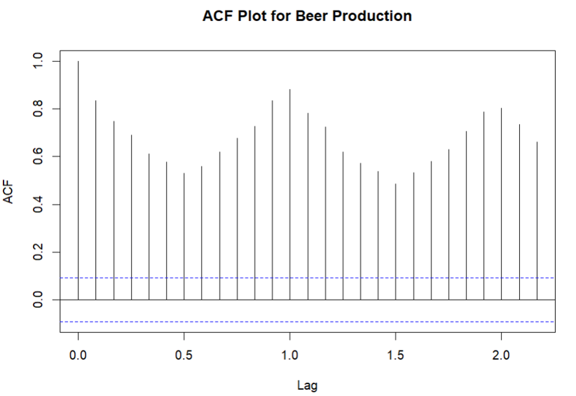
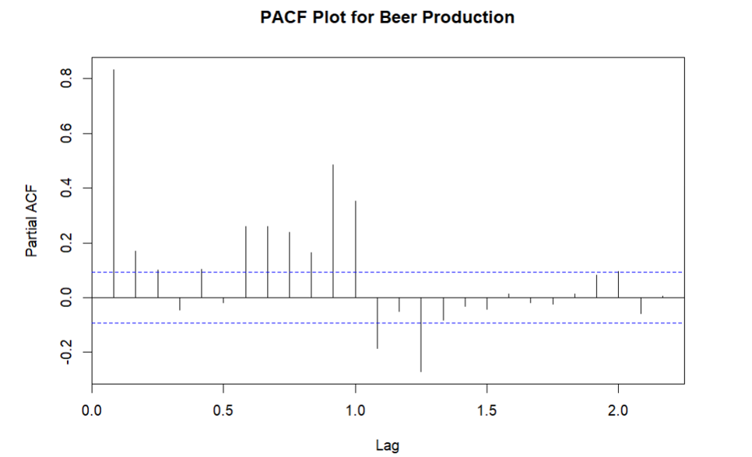
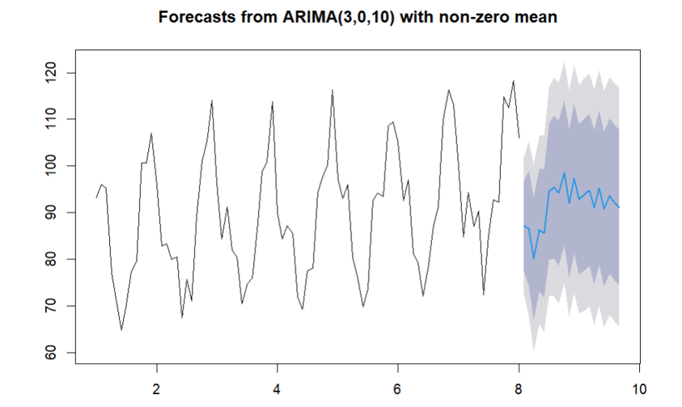
Output received after analysis process

Slide 11
Mean absolute error between forecasted and actual values:
Mean Absolute Error (MAE) Calculation: The MAE, computed as 8.99, measures the average absolute difference between forecasted and actual values.
Error Assessment: MAE represents the average deviation of forecasted values from actual observations in the test dataset.
Accuracy Measure: Lower MAE values indicate higher prediction accuracy, with values closer to zero signifying more precise forecasts.
Model Performance: With an MAE of 8.99, the ARIMA model's forecasts deviate by approximately 8.99 units on average from actual production values.
Decision Support: The MAE assessment aids decision-making in production planning and resource allocation within the beer production industry.

Slide 12
Challenges & Improvements:
Model selection and parameter tuning required domain expertise and iterative analysis.
Identifying seasonality and trends in beer production data was challenging.
Evaluating forecast accuracy and reliability posed ongoing difficulties.
Explore advanced modelling techniques like SARIMA or LSTM networks.
Use ensemble modelling approaches for improved prediction accuracy.
Implement continuous model evaluation and updating frameworks.
Integrate external factors such as weather patterns into forecasting models.
Foster collaboration among domain experts and stakeholders for innovative solutions.

Slide 13
Effectiveness of chosen Model
The chosen ARIMA models demonstrated reasonable forecasting accuracy, with the manually selected parameters leading to a slightly improved model performance compared to automated selection.
Despite the challenges faced in model selection and evaluation, the ARIMA models successfully captured the general trend and seasonality in the data, providing valuable insights for decision-making in the brewing industry.
The models' effectiveness in forecasting beer production trends suggests their potential utility for strategic planning, resource allocation, and operational optimization within the brewing industry landscape.

Slide 14
Predictions:
Beer production is expected to continue exhibiting seasonal patterns and underlying trends, influenced by factors such as consumer demand, economic conditions, and seasonal variations.
Forecasted production trends can serve as valuable inputs for production planning, inventory management, and marketing strategies within the brewing industry.

Slide 15
Conclusion:
Time series analysis emerges as a potent instrument for predicting beer production trends. Although the models crafted within this project yield valuable insights, there exists considerable room for enhancement and fine-tuning. Through the resolution of challenges and the integration of forthcoming advancements, we endeavor to construct forecasting models that are not only more resilient but also more precise. This pursuit aims to empower decision-makers within the brewing industry with the foresight necessary for informed strategic choices.

